Slide 1
Reflection of Light from a Concave Mirror Forming Virtual Images

Slide 2
When you have completed this lesson you should be able to:
Understand the behaviour of three principal rays drawn when creating ray diagrams for virtual images.
Draw ray diagrams for the reflection of an object from a concave mirror forming virtual images.
Describe the nature of the image produced by a concave mirror given the location of the object.

Slide 3
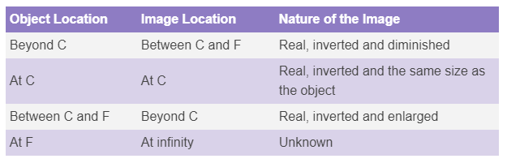
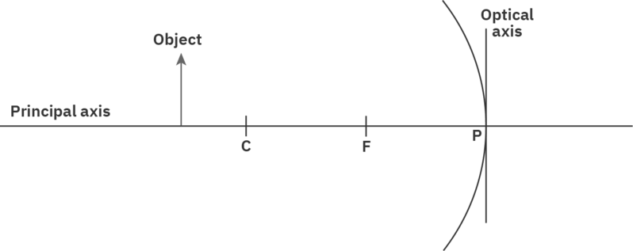
The location of the object with respect to the centre of curvature and focus of a concave mirror determines the nature of the image that will be formed.
The table below shows a summary of the location of the object and the nature of the image formed.

Slide 4
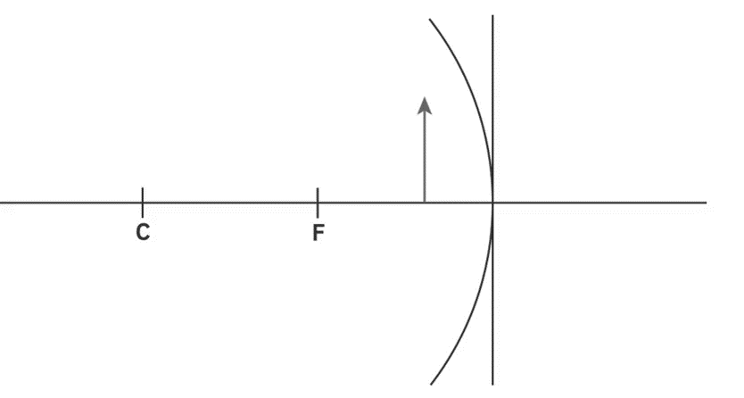
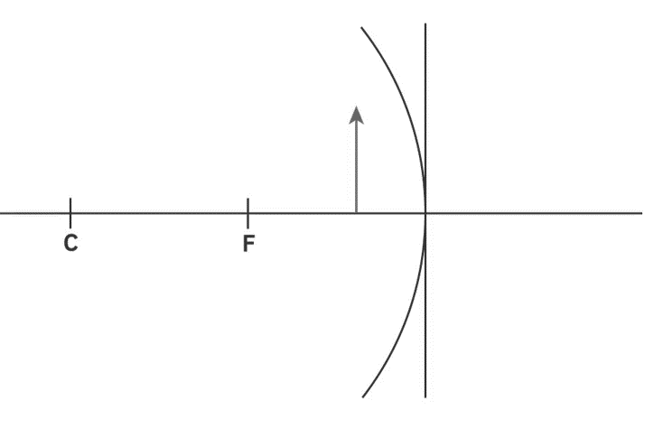
From our summary table it is clear we have not considered what sort of image will be formed when the object is placed within the focal length of a concave mirror.
This means the object will be located to the right of the focus (between the focus and the edge of the mirror). In this case two of the principal rays can be drawn in the same way as before.
One principal ray will be incident parallel to the principal axis and will be reflected through the focus. The other principal ray will be incident to the pole of the mirror and be reflected with the same angle as the angle of incidence.

Slide 5
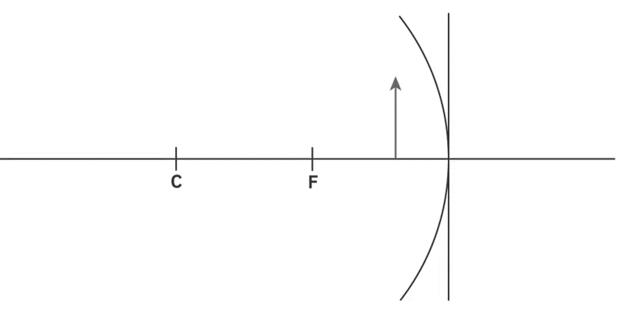
The third principal ray will need to be drawn in a different order.
Usually we start at the top of the object, travel through the focus and continue on to the mirror. However, the focus is now behind the object. If we start at the top of the object and travel through the focus the ray will be moving away from the mirror.
In this situation, we start at the focus of the mirror, travel through the top of the object and then continue on to the mirror. The reflected ray will still travel parallel to the principal axis.

Slide 6
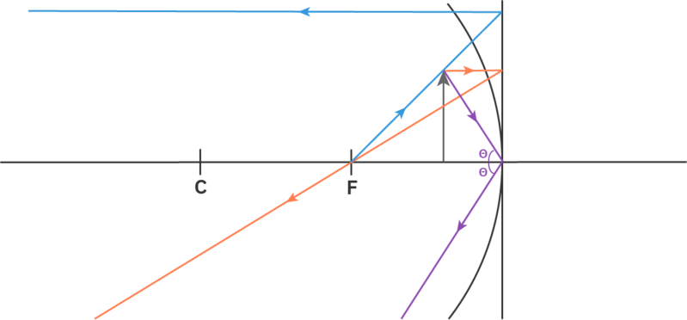
Putting all three principal rays on the ray diagram, we can see that they do not converge.
There is no point at which all three reflected rays will meet, so no real image can be formed. However, we can create a virtual image.
A virtual image is formed from virtual rays and will not be able to be seen on a screen. We will only be able to observe a virtual image when we look into the mirror and it will appear to be placed behind the mirror.

Slide 7
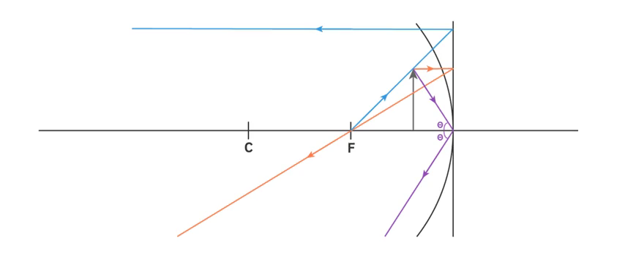
To locate the virtual image, we backtrace the reflected principal rays.
This means we find the location where the reflected principal rays meet the concave mirror and trace them behind the mirror, making sure to keep the same angles for our lines. When we trace rays behind the mirror, it is referred to as backtracing and the rays are drawn using dotted lines.
It is not possible for light rays to travel behind the mirror, so these backtraced rays are called virtual rays. The intersection of the virtual rays identifies the location of the virtual image.

Slide 8
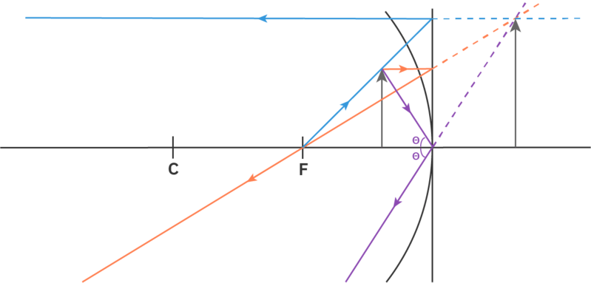
Now that we understand how to draw ray diagrams for virtual images, we can describe the nature of the image formed.
Virtual images are created by the intersection of virtual light rays. Virtual images are always upright and upright images are always virtual. When we use a concave mirror to create a virtual image it is always larger than the object, as shown in the ray diagram below. Thus, the nature of the image shown below is virtual, upright and enlarged.

Slide 9
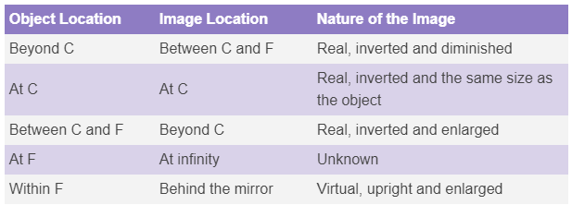
Reflecting light from a concave mirror can produce many different types of images, depending on the location of the object.
These types of images are summarised in the table below.

